Slide 1
CSCI 4/5588 ML-II Chapter #6: Random Forest
Md Tamjidul Hoque

Slide 2
Overview
We will be studying
Bootstrap methods
Bagging
Boosting methods
Decision Trees
Random Forest
Ensemble Learning

Slide 3
Bootstrap Methods
The bootstrap is a general tool for assessing statistical accuracy.
Suppose we have a model fit to a set of training data. We denote the training set by Z = (z₁, z₂, … , z_{N}) where z_{i} = (x_{i}, y_{i}). The basic idea is to
randomly draw datasets with replacement from the training data,
this is done B times (B = 100 say), producing B bootstrap datasets, as shown in Figure (next Slide).
Then we refit the model to each of the bootstrap datasets, and examine the behavior of the fits over the B replications.

Slide 4
Bootstrap Methods
Schematic of the bootstrap process:
> We wish to assess the statistical accuracy of a quantity S(Z) computed from our dataset.
> B training sets Z^{∗b}, b = 1, …, B each of size N are drawn with replacement from the original dataset.
> The quantity of interest S(Z) is computed from each bootstrap training set, and the values S(Z^{∗1}) , … , S(Z^{∗B}) are used to assess the statistical accuracy of S(Z).
Notes:
Bootstrapped quantities are indicated by superscript *.

Slide 5
Bootstrap Methods
In the figure, S(Z) is any quantity computed from the data Z, for example, the prediction at some input point.
From the bootstrap sampling we can estimate any aspect of the distribution (say, distribution function F for the data (z₁, z₂, … , z_{N})) of S(Z), for example, its variance,
where mean,
The larger the number of B of bootstrap samples, the more satisfactory is the estimate of a statistic and its variance. One of the benefits of bootstrap estimation is that B can be adjusted to the computational resources.
Notes:
Bootstrapped quantities are indicated by superscript *.

Slide 6
Bootstrap Methods
How can we apply the bootstrap to estimate prediction error?
One approach would be to fit the model in question on a set of bootstrap samples, and then keep track of how well it predicts the original training set.

Slide 7
Bagging
Bagging is basically bootstrap aggregation.
Bootstrap has been shown to be a way of assessing the accuracy of a parameter estimate or a prediction.
Consider first the regression problem;
Bootstrap aggregation or bagging averages this prediction over a collection of bootstrap samples, thereby reducing its variance.

Slide 8
Boosting Methods
Boosting is one of the most powerful learning ideas introduced in the last twenty years. It was originally designed for classification problems, but it can be used for regression as well.
The motivation for boosting was a procedure that combines the outputs of many “weak” classifiers to produce a powerful “committee.”
We will see “AdaBoost.M1”, the most popular boosting algorithm:
Consider a two-class problem, with the output variable coded as Y ∈ {−1, 1}. Given a vector of predictor variables X, a classifier G(X) produces a prediction taking one of the two values {−1, 1}. The error rate on the training sample is
Notes:
Some latest boosting algorithms are:
Gradient Boosting Machine (GBM)
Extreme Gradient Boosting Machine (XGBM)
LightGBM
CatBoost

Slide 9
Boosting Methods
A weak classifier is one whose error rate is only slightly better than random guessing.
The purpose of boosting is to sequentially apply the weak classification algorithm to repeatedly modified versions of the data, thereby producing a sequence of weak classifiers G_{m}(x), m = 1, 2, …, M.
The predictions from all of them are then combined through a weighted majority vote to produce the final prediction:
Here α₁, α₂, …, α_{M} are computed by the boosting algorithm, and weight the contribution of each respective G_{m}(x). Their effect is to give higher influence to the more accurate classifiers in the sequence.

Slide 10
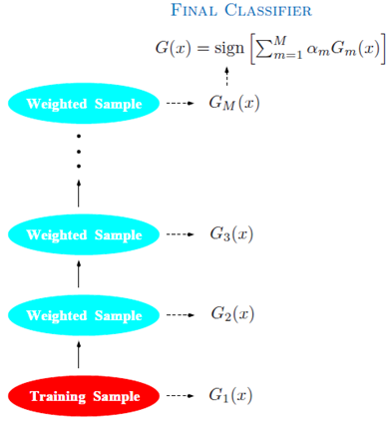
Boosting Methods
FIGURE: Schematic of AdaBoost.
Classifiers are trained on weighted versions of the dataset, and then combined to produce a final prediction.

Slide 11
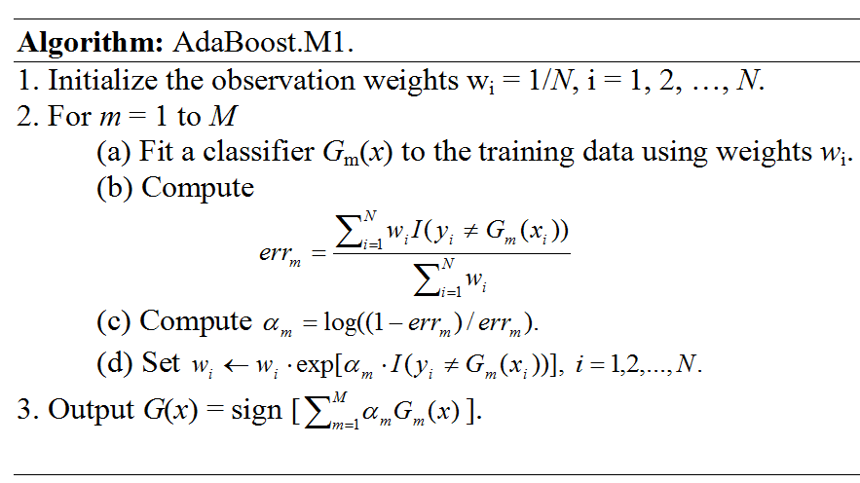
Boosting Methods
Notes:
AdaBoost => Adaptive Boosting
alpha = logit (error)= log-ratio (error)
Example: err =0.9, alpha = log(0.1/0.9) = - 0.9542. => w = w x e^ (-0.9542) = w x 0.385158.
err = 0.1, alpha = log(0.9/0.1) = 0.9542 => w = w x e^ (0.9542) = w x 2.5963.
=> err(high) = alpha (low) or, inversely proportional.
=> Less error should have higher weight now to influence the predictor to consider it.

Slide 12
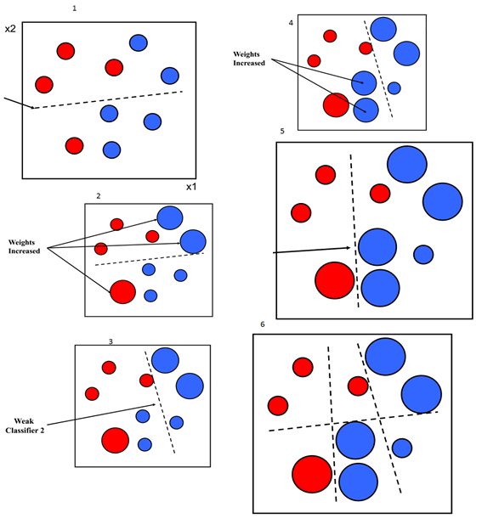
Example 1: (Binary-classification) How does the boosting work?
Decision boundary

Slide 13
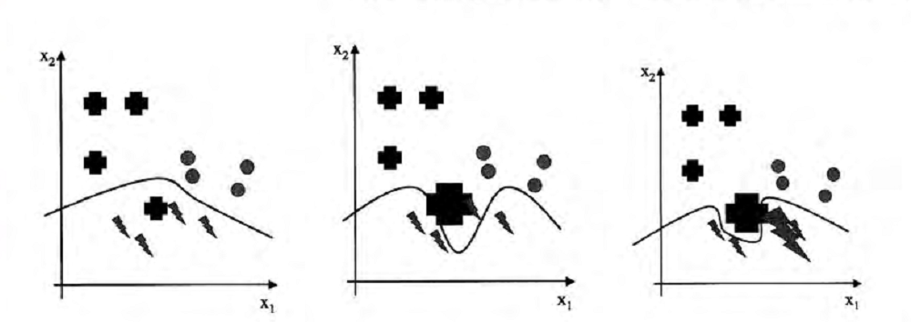
Example 2: (Multiclass) How does the boosting work?
Notes:
Ref: Book #4. Assume multiclass classification and one-versus-rest. Here, carrot-shape versus rest.

Slide 14



Decision Trees
There are various simple, but widely used, models that work by partitioning the input space into cuboid regions, whose edges are aligned with the axes, and then assigning a simple model (for example, a constant) to each region.
They can be viewed as a model combination method in which only one model is responsible for making predictions at any given point in input space.
The process of selecting a specific model, given a new input x, can be described by a sequential decision-making process corresponding to the traversal of a binary tree (one that splits into two branches at each node).
Here, we focus on a particular tree-based framework called classification and regression trees, or CART (Breiman et al., 1984).

Slide 15




Decision Trees
Figure 1(a): Illustration of a two-dimensional input space that has been partitioned into five regions using axis-aligned boundaries.
1(b): Binary tree corresponding to the partitioning of input space shown in Figure 1(a).

Slide 16
Decision Trees
Within each region, there is a separate model to predict the target variable.
For instance, in regression we might simply predict a constant over each region, or in classification we might assign each region to a specific class.
A key property of tree-based models, which makes them popular in fields such as medical diagnosis, for example, is that they are readily interpretable by humans because they correspond to a sequence of binary decisions applied to the individual input variables.
For instance, to predict a patient's disease, we might first ask “is their temperature greater than some threshold?”. If the answer is yes, then we might next ask “is their blood pressure less than some threshold?” Each leaf of the tree is then associated with a specific diagnosis.

Slide 17
Decision Trees
In order to learn such a model from a training set, we have to determine the structure of the tree:
including which input variable is chosen at each node to form the split criterion as well as
the value of the threshold parameter θ_{i} for the split.
We also have to determine the values of the predictive variable within each region.

Slide 18
Decision Trees
Consider first a regression problem in which the goal is to predict a single target variable t from a D-dimensional vector x = (x₁ , …, x_{D})^{T} of input variables.
The training data consists of input vectors {x₁, ..., x_{N} } along with the corresponding continuous labels {t₁ , …, t_{N}}.
If the partitioning of the input space is given, and we minimize the sum-of-squares error function, then the optimal value of the predictive variable within any given region is just given by the average of the values of t_{n} for those data points that fall in that region.

Slide 19
Decision Trees
How to determine the structure of the decision tree:
Even for a fixed number of nodes in the tree, the problem of determining the optimal structure (including choice of input variable for each split as well as the corresponding thresholds) to minimize the sum-of-squares error is usually computationally infeasible due to the combinatorially large number of possible solutions.
Instead, a greedy optimization is generally done by starting with a single root node, corresponding to the whole input space, and then growing the tree by adding nodes one at a time.
At each step there will be some number of candidate regions in input space that can be split, corresponding to the addition of a pair of leaf nodes to the existing tree.
For each of these, there is a choice of which of the D input variables to split, as well as the value of the threshold.
The joint optimization of the choice of region to split, and the choice of input variable and threshold, can be done efficiently by exhaustive search noting that, for a given choice of split variable and threshold, the optimal choice of predictive variable is given by the local average of the data, as noted earlier.
This is repeated for all possible choices of variable to be split, and the one that gives the smallest residual sum-of-squares error is retained.

Slide 20
Decision Trees
When to stop growing the Tree:
stop when the reduction in residual error falls below some threshold
often none of the available splits produces a significant reduction in error, thus
it is common practice to grow a large tree, using a stopping criterion based on the number of data points associated with the leaf nodes, and then prune back the resulting tree.
The pruning is based on a criterion that balances residual error against a measure of model complexity.
Mostly, we use negative cross-entry and/or Gini-index … the main idea is, they encourage the formation of regions in which a high proportion of the data points are assigned to one class.

Slide 21
Random Forest
The essential idea in bagging is to average many noisy but approximately unbiased models, and hence reduce the variance.
Trees are ideal candidates for bagging, since they can capture complex interaction structures in the data, and if grown sufficiently deep, have relatively low bias.
Since trees are notoriously noisy, they benefit greatly from the averaging.
Moreover, since each tree generated in bagging is identically distributed (i.d.), the expectation of an average of B such trees is the same as the expectation of any one of them. This means the bias of bagged trees is the same as that of the individual trees, and the only hope of improvement is through variance reduction.

Slide 22
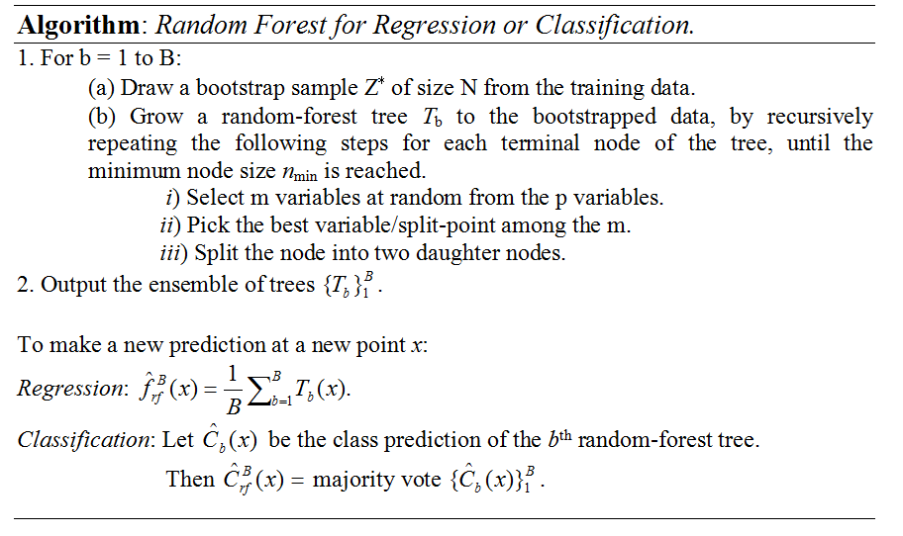





Random Forest
Notes:
Note: {…}₁, here the ‘1’ is indicating bootstrap sample number 1.

Slide 23
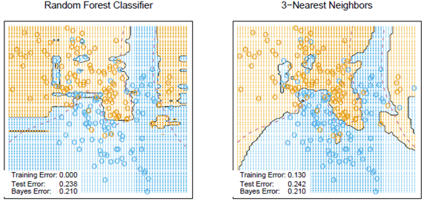

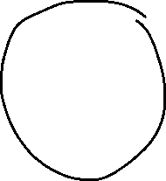

Random Forest
FIGURE: Random forests versus 3-NN on the mixture data. The axis-oriented nature of the individual trees in a random forest lead to decision regions with an axis-oriented flavor.

Slide 24
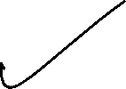
Ensemble Learning
The idea of ensemble learning is to build a prediction model by combining the strengths of a collection of simpler base models.
Bagging and random forests are ensemble methods for classification, where a committee of trees each cast a vote for the predicted class, ….
Ensemble learning can be broken down into two tasks:
developing a population of base learners from the training data, and
then combining them to form the composite predictor.
And the composite predictor is expected to perform better than the individual.
---- x -----

